Slide 1
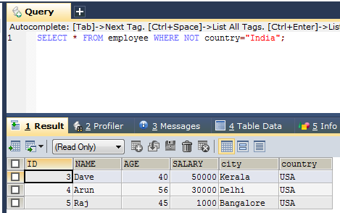
SQL NOT Operator
The WHERE clause can be combined with AND, OR, and NOT operators.
The NOT operator displays a record if the condition(s) is NOT TRUE
SELECT * FROM employee WHERE NOT country="India";
SELECT column1, column2, ... FROM table_name WHERE NOT condition;

